Slide 1
Presentation of the paper: “A view of Validity of BMI as a measure of obesity in Australian white Caucasian and Australian Sri Lankan children” by V. P. Wickramasinghe, G. J. Cleghorn, K. A. Edmiston, A. J. Murphy, R. A. Abbott & P. S. W. Davies
Presented by Morten Rasmus Puck

Slide 2
Paper introduction
The paper is about to validate the Body Mass Index (BMI) as a valid construct to measure obesity among children.
Obesity is defined by cut-off values in the %-fat-mass (%FM) scale, where the cut-off values are found in the health literature. This is a definition, and therefore something to aim at.
BMI is an approximation to %FM, and its validation are based on a parallel form testing to see if BMI detects the same individuals as obese as %FM. The validity is the reliability.
Both BMI and %FM are continuous scales, but at both scales the use cut-offs. And to diagnose obesity by using the BMI, the BMI has to predict the same outcome as the %FM.
Classic BMI cut-off are determined by cut-off values for adults. And should be the same cut-off for everybody.
The paper examining if this is the case.

Slide 3
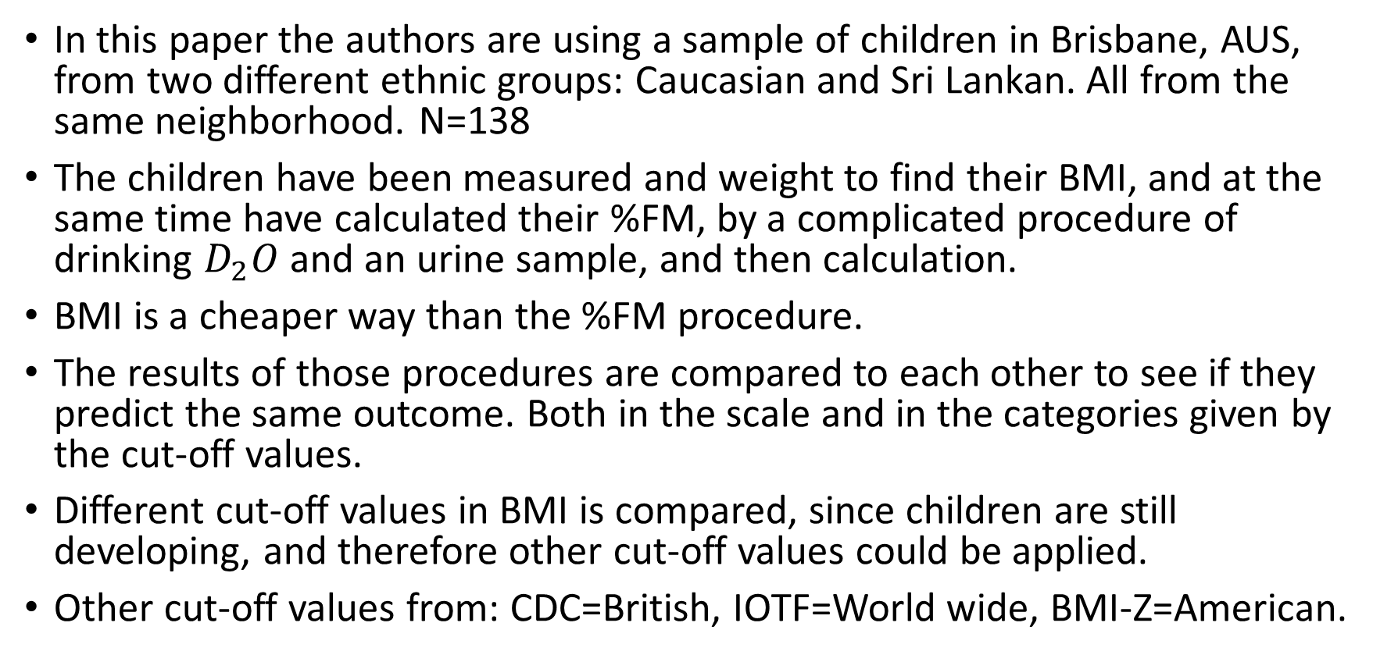
Wickramasinghe et al, paper method
In this paper the authors are using a sample of children in Brisbane, AUS, from two different ethnic groups: Caucasian and Sri Lankan. All from the same neighborhood. N=138
The children have been measured and weight to find their BMI, and at the same time have calculated their %FM, by a complicated procedure of drinking $D_{2}O$ and an urine sample, and then calculation.
BMI is a cheaper way than the %FM procedure.
The results of those procedures are compared to each other to see if they predict the same outcome. Both in the scale and in the categories given by the cut-off values.
Different cut-off values in BMI is compared, since children are still developing, and therefore other cut-off values could be applied.
Other cut-off values from: CDC=British, IOTF=World wide, BMI-Z=American.

Slide 4
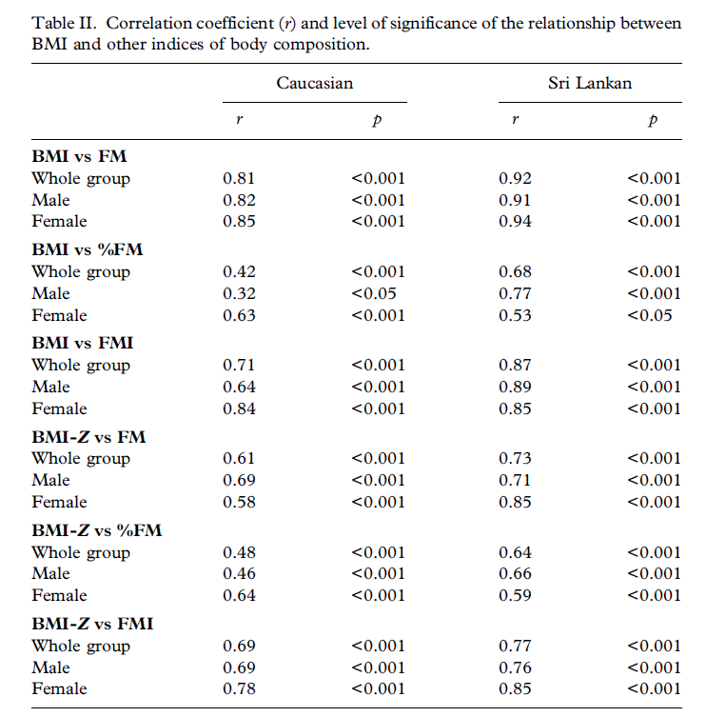
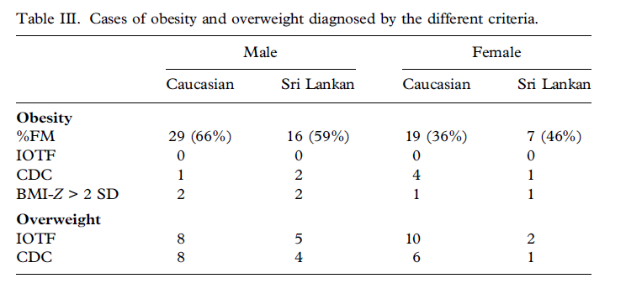

Slide 5
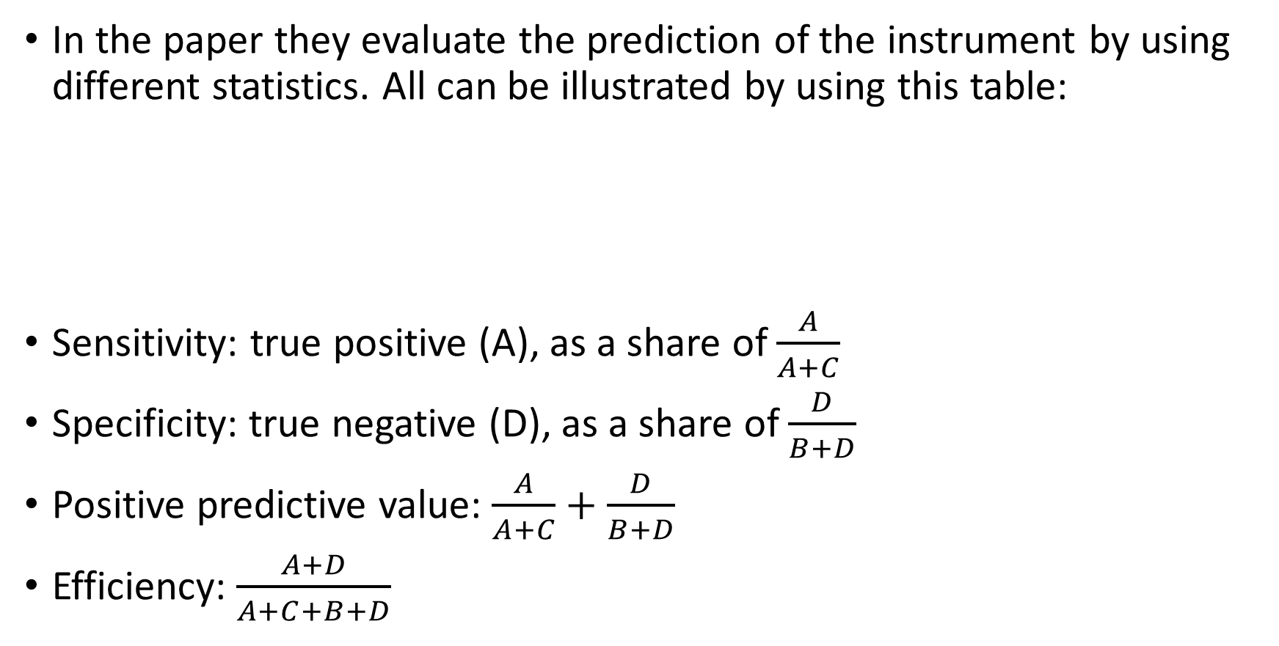
Prediction in the paper
In the paper they evaluate the prediction of the instrument by using different statistics. All can be illustrated by using this table:
Sensitivity: true positive (A), as a share of $\frac{A}{A+C}$
Specificity: true negative (D), as a share of $\frac{D}{B+D}$
Positive predictive value: $\frac{A}{A+C}+\frac{D}{B+D}$
Efficiency: $\frac{A+D}{A+C+B+D}$
 |  | BMI
 |  | Obese | No obese
%FM | Obese | A | B
 | No obese | C | D

Slide 6
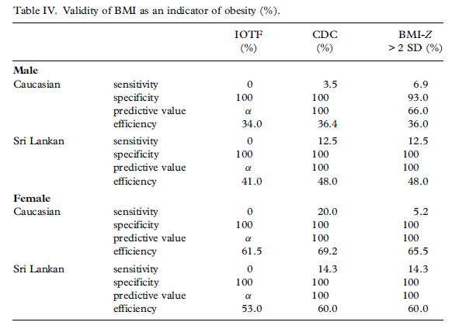

Slide 7
Conclusion
There are little evidence of validity of using BMI as a diagnostic tool of obesity.
The reliability in the parallel form testing between different cut-off values in BMI and the cut-off values in the %FM are low, almost non-existing.
The correlation between the two continouos variables is high in an socialscience context, but rather low in a health science context.
So even if finding optimale cut-off-levels the validity of using BMI as a diagnositic tool will be low to non-existing.
But using BMI as an indicator is more a question about beliefs, since it is cheaper than the whole proces behind the %FM scale.

